Slide 1
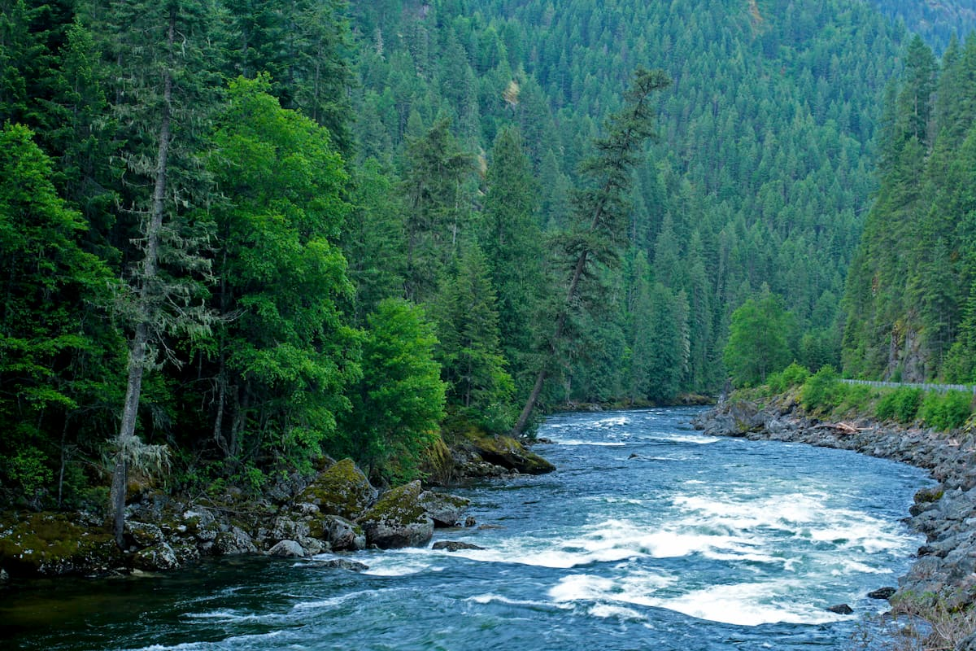
WW36’23 CWF SBFT Introduction
Bryan Gomez

Slide 2
Agenda
What is CWF?
SoC Disaggregation
CWF CPU construction
GNR/SRF/CWF features comparison
CWF core tile
CWF vs GNR

Slide 3
What is CWF?
Atom based, high-throughput performance, Xeon server.
Second Forest line server product, preceded by Sierra Forest (SRF).
Built to augment Xeon's workload coverage.
CWF trades off execution latency for throughput performance.

Slide 4
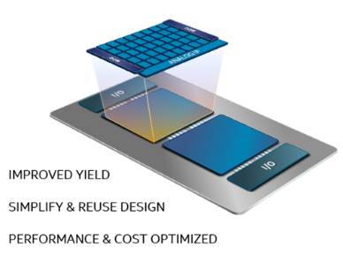
SoC Disaggregation

Slide 5
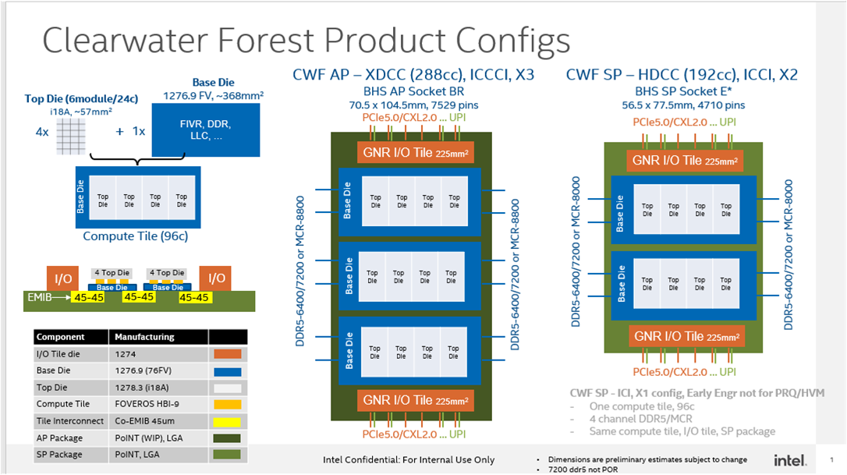
CWF CPU Construction

Slide 6
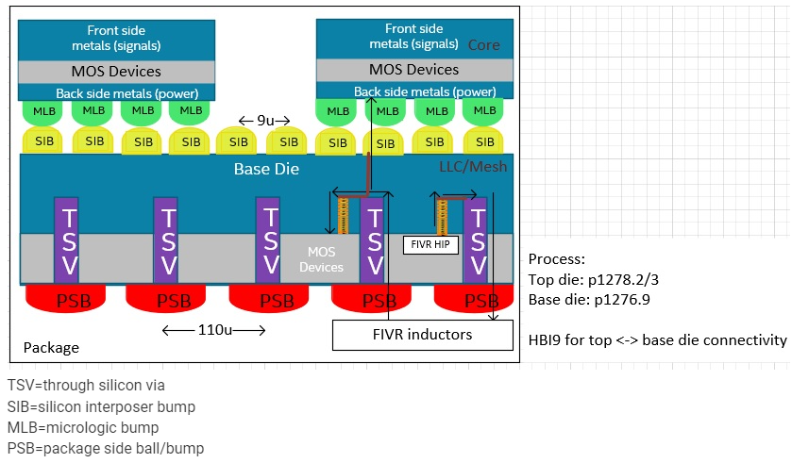
CWF CPU Construction

Slide 7
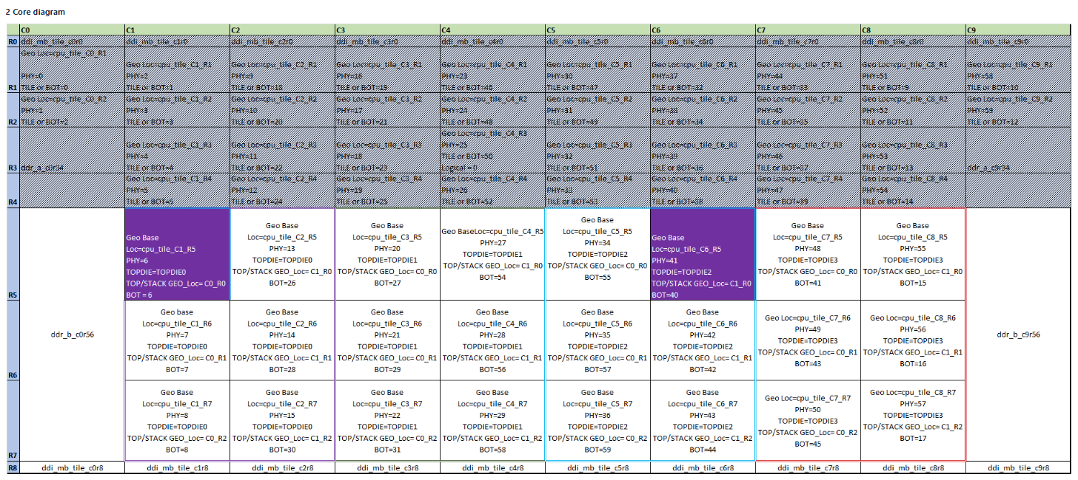
CWF CPU Construction

Slide 8
GNR/SRF/CWF features comparison
Feature | GNR | SRF | CWF
Module | RWC big core | CMT/SGL atom | DKT/FGL atom
Threads | 2t per core | 4 cores per module, 1 thread per core | 4 cores per module, 1 thread per core
MLC size | 2MB per coretile | 4MB per module | 4MB per module
LLC size | 4MB/CHA | 3MB/CHA | 8MB/CHA
AVX/ICCP licensing | SSE, AVX2, AVX3,AMX | SSE | SSE

Slide 9
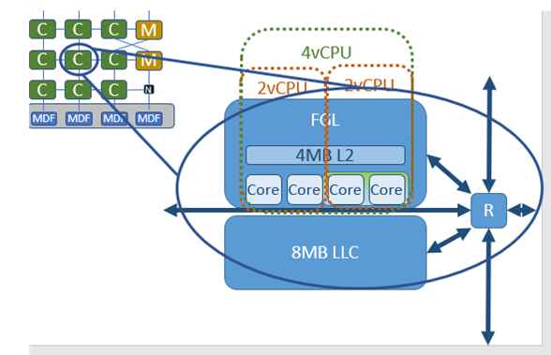
CWF Coretile

Slide 10
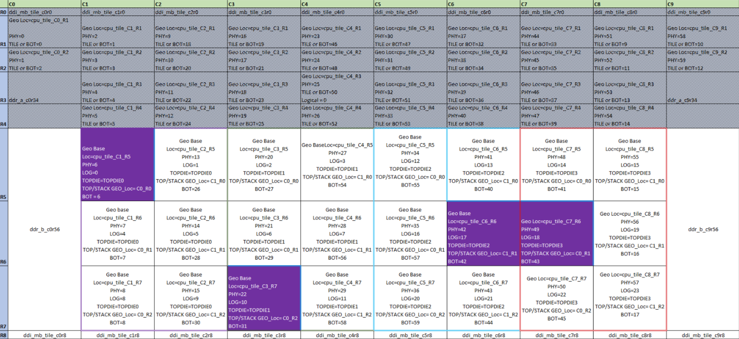
CWF Coretile

Slide 11
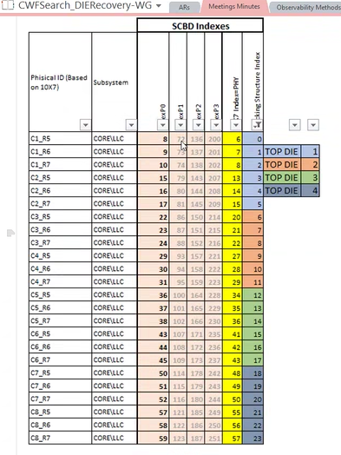
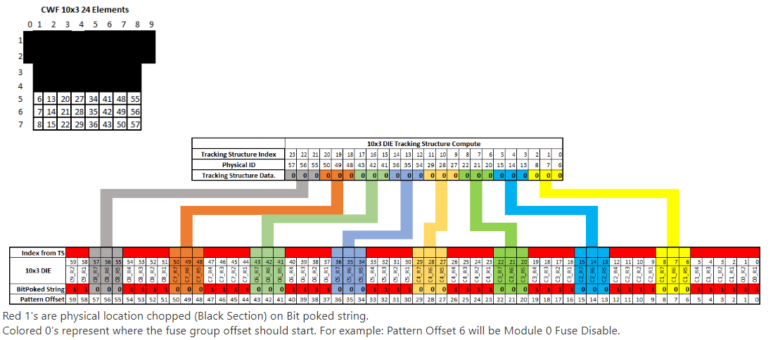
CWF DieRecovery Strategy

Slide 12
CWF vs GNR
Native Support for Core Lockstep.
Core PMA registers programmable directly using core tap avoiding tap2sb interfaces and take advantages of GBA taplink parallelism.
L2 padding to return fake cache lines from preset DATIN registers on biu fetch, set to 0xF4s (HALT opcode).
Special Content Tests
Trunkdbg: is used to detect the speed path in trunk clock gating logic that for each core and L2.
Bilbo: tests are meant to cover the connection between SOC and CPU as well as covering the BGF FIFOs with the cross clock domains.
CWF uses HWRS for Reset. GNR uses Punit based reset with stagging array.
CWF have the capability of Dynamic lockstep.
First atom product planned to use self signature protocol.
Content checks:
0xaced signature
MCA checks
SCMISR check

